Slide 1

TENSORFLOW 2.0
PRACTICAL ADVANCED

Slide 2

WHAT IS AI? WHAT IS MACHINE LEARNING? AND DEEP LEARNING?!

Slide 3






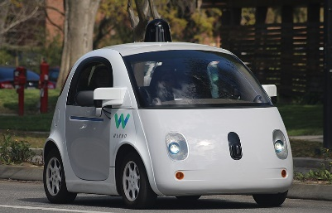
INTRODUCTION
Artificial Intelligence/Machine learning does not only mean robots or Sci-Fi movies!
Machine and deep learning applications are everywhere!
Google search engine, amazon recommender systems, Facebook facial recognition (tagging), Siri
Photo Credit: https://commons.wikimedia.org/wiki/File:Waymo_self-driving_car_front_view.gk.jpg
Photo Credit: http://blog.etonic.net/index.php?entry=entry110316-081129
Photo Credit: https://www.flickr.com/photos/topgold/8325104250
Photo Credit: https://picryl.com/media/google-search-engine-magnifying-glass-computer-communication-00b825
Photo Credit: https://www.flickr.com/photos/iphonedigital/26988770454
Photo Credit: https://pixabay.com/illustrations/flat-recognition-facial-face-woman-3252983/

Slide 4
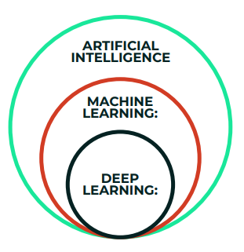
ARTIFICIAL INTELLIGENCE Vs. MACHINE LEARNING Vs. DEEP LEARNING: BIG PICTURE

Slide 5
1. ARTIFICIAL INTELLIGENCE
Science that empowers computers to mimic human intelligence such as decision making, text processing, and visual perception.
AI is a broader field (i.e.: the big umbrella) that contains several subfield such as machine learning, robotics, and computer vision.

Slide 6
2. MACHINE LEARNING
Machine Learning is a subfield of Artificial Intelligence that enables machines to improve at a given task with experience.
It is important to note that all machine learning techniques are classified as Artificial Intelligence ones. However, not all Artificial Intelligence could count as Machine Learning since some basic Rule-based engines could be classified as AI but they do not learn from experience therefore they do not belong to the machine learning category.

Slide 7
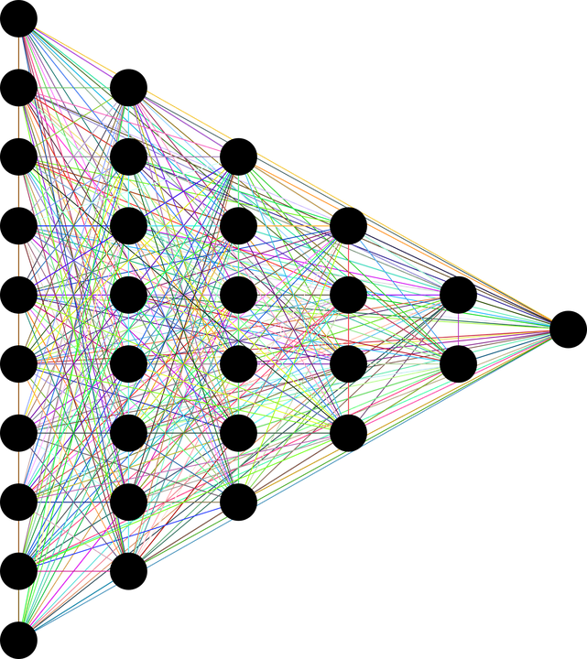
3. DEEP LEARNING
Deep Learning is a specialized field of Machine Learning that relies on training of Deep Artificial Neural Networks (ANNs) using large dataset such as images.
ANNs are information processing models inspired by the human brain.
The human brain consists of billions of neurons that communicate to each other using electrical and chemical signals and enable humans to see, feel, and make decision.
TARGET OUTPUTS
DEEP (HIDDEN LAYERS)
Photo Credit: https://pixabay.com/en/neural-network-thought-mind-mental-3816319/

Slide 8
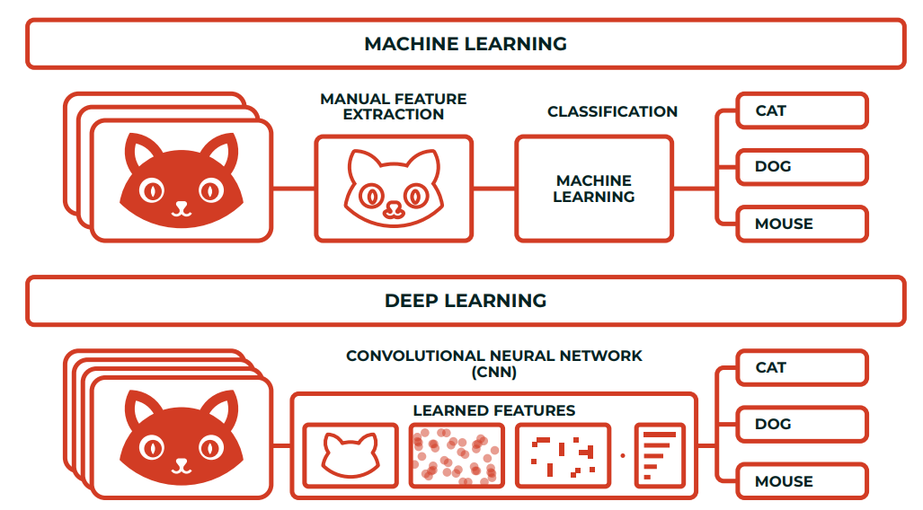
MACHINE VS. DEEP LEARNING
What differentiates deep learning from machine learning techniques is in their ability to extract features automatically:
Machine learning Process: (1) select the model to train, (2) manually perform feature extraction.
Deep Learning Process: (1) Select the architecture of the network, (2) features are automatically extracted by feeding in the training data (such as images) along with the target class (label).

